Slide 1

PRESENTED BY:
1.AMIT KUMAR NAYAK(2101104061)
2.ASEET GOURAB SWAIN(2101104067)
3.JYOTIRANJAN MOHANTA(2101104079)
4.LALKRISHNA BEHERA(2101104082)
5.SHUBHANKAR SAHU(2101104099)
GUIDED BY:
DR. MUKESH BATHRE
HOD,CSE

Slide 2

TABLE OF CONTENT :
ABSTRACT
INTRODUCTION
PROBLEM STATEMENT
MOTIVATION
OBJECTIVE
LITERATURE SURVEY
METHODOLOGY AND TOOLS
IMPLEMENTATION
GANTT CHART
DATA READING
DATA VISUALIZATION
MODEL TRANING
MODEL EVALUTION
CONCLUSION
FUTURE SCOPE

Slide 3
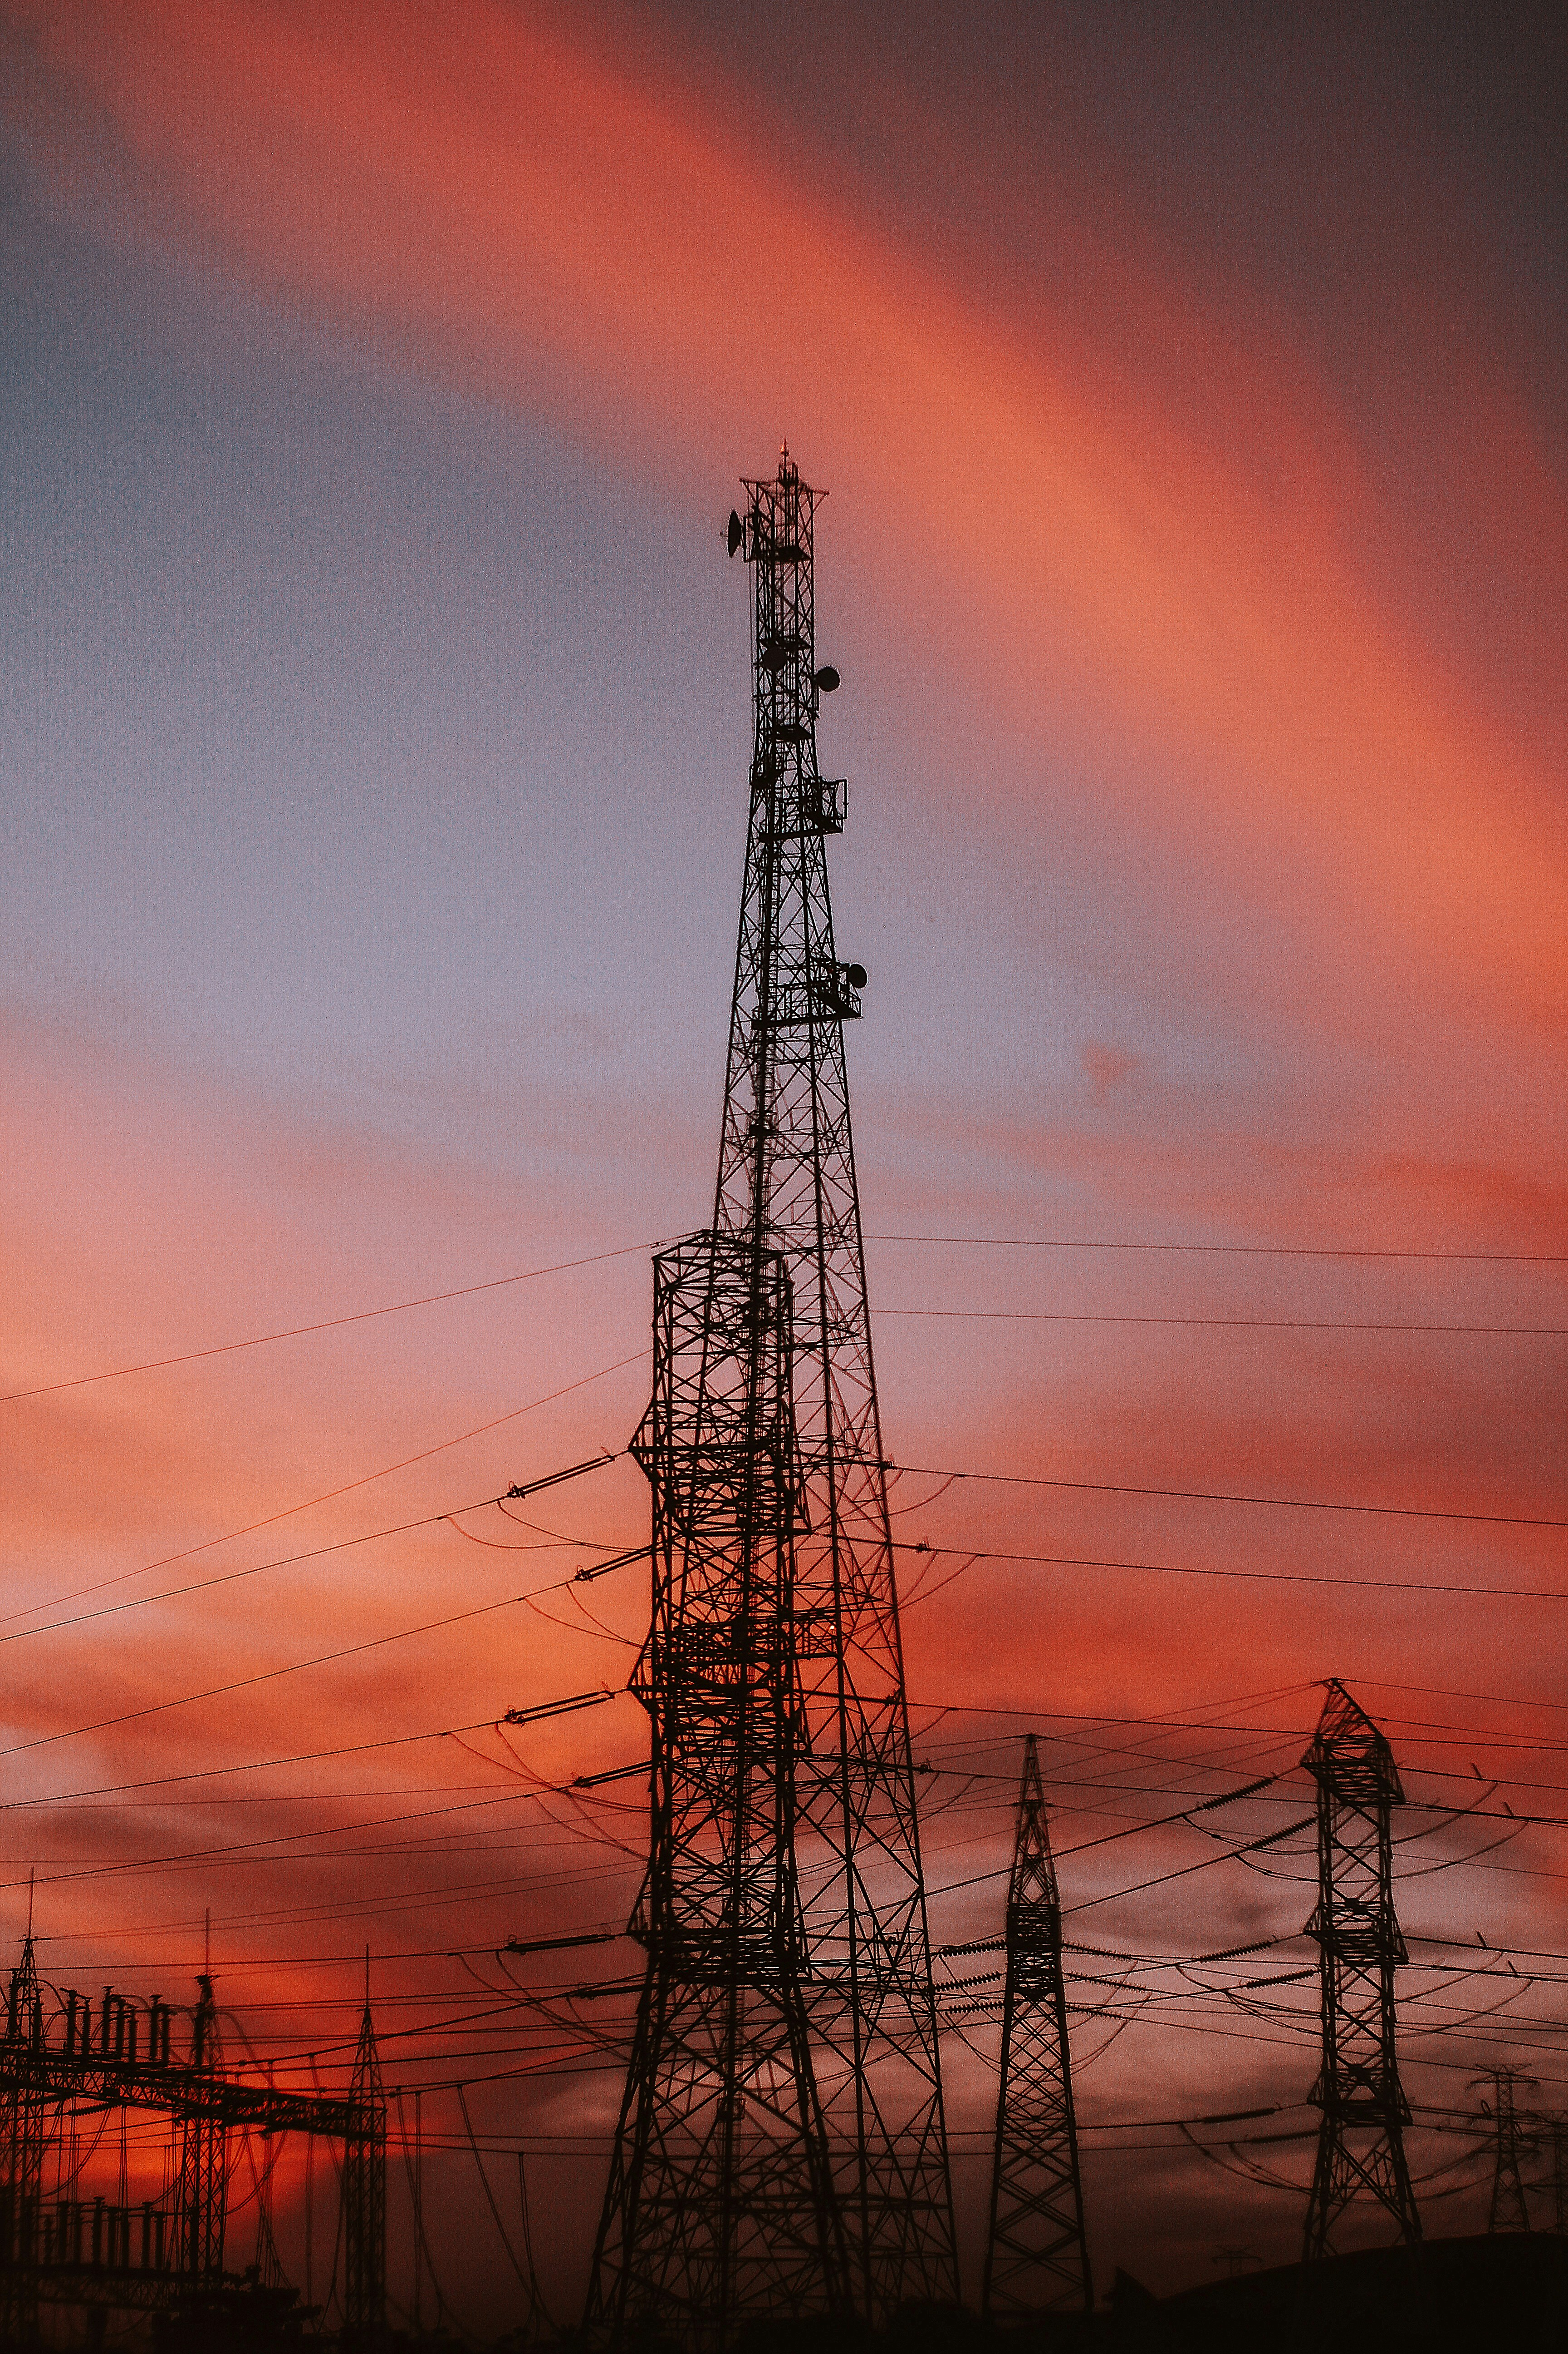
ABSTRACT
Accurate electricity consumption prediction is essential for energy providers, policymakers, and consumers to ensure efficient resource allocation, reduce costs, and promote sustainable energy practices. This project leverages machine learning techniques to develop a predictive model for electricity consumption based on historical data and influencing factors such as time, weather, and usage patterns. By analyzing large datasets and identifying key trends, the system aims to forecast short-term and long-term electricity demand with high accuracy.
The project involves preprocessing raw data, feature engineering, and training multiple machine learning algorithms such as regression models, decision trees, and neural networks .The results demonstrate how machine learning can handle complex dependencies and nonlinear relationships in electricity usage data, outperforming traditional forecasting methods.
The predictive insights from this model will empower utility providers to optimize grid operations, reduce energy waste, and plan for peak demand effectively. Additionally, consumers can benefit from personalized energy-saving recommendations. This study highlights the potential of machine learning in addressing modern energy challenges and contributing to a more sustainable future.

Slide 4

INTRODUCTION:
Welcome to our presentation on electricity consumption and prediction using machine learning algorithms. Electricity, the lifeblood of modern society, powers our homes, businesses, and industries. As our reliance on electricity grows, so does the need for effective strategies to manage its consumption and ensure reliable supply. In this presentation, we'll delve into the world of electricity consumption forecasting and explore how machine learning can play a crucial role in this critical area.
This project focuses on developing a machine learning-based system for electricity consumption prediction. The project involves data collection, preprocessing, feature engineering, model training, and evaluation. Various ML algorithms, including regression models, decision trees, and neural networks, will be explored to identify the most effective approach.

Slide 5
PROBLEM STATEMENT?
Accurately predicting electricity consumption is a critical challenge faced by energy providers and consumers. Traditional methods of forecasting electricity demand often fail to capture the complex, dynamic relationships influenced by factors such as weather patterns, time of use, economic activities, and consumer behavior. This lack of accurate prediction leads to inefficiencies in energy production, distribution, and consumption, resulting in higher costs, energy wastage, and grid instability.
Machine learning provides a powerful solution to this problem by analyzing large volumes of historical data and uncovering patterns that traditional models cannot detect. By leveraging data-driven insights, the project seeks to optimize energy management, support decision-making, and contribute to a more sustainable and efficient energy system.
Key Questions to Address:
How can historical data and external factors be integrated to improve prediction accuracy?
What machine learning algorithms are most effective for this task?
How can the developed model adapt to changing consumption patterns over time?

Slide 6

Motivation
The motivation behind this project stems from the pressing need for efficient energy management in a world facing increasing energy demands, climate change challenges, and the push for sustainability. Electricity is the backbone of modern society, powering industries, homes, and technologies. However, inefficient management of electricity supply and demand can lead to significant problems, such as resource wastage, increased operational costs, grid instability, and environmental damage.
1
Energy Efficiency
2
Cost Reduction
Accurate prediction enables better planning and optimization of energy production and distribution, reducing waste and promoting efficient energy usage.
Reliable forecasts help minimize costs associated with energy overproduction, underutilization, and peak demand management.
3
Grid Stability
4
Technological Advancement:
Predicting demand helps utilities maintain grid stability, preventing overloads and ensuring a seamless flow of electricity.
Leveraging ML in electricity prediction showcases the potential of artificial intelligence to solve real-world challenges, driving innovation in the energy sector.

Slide 7
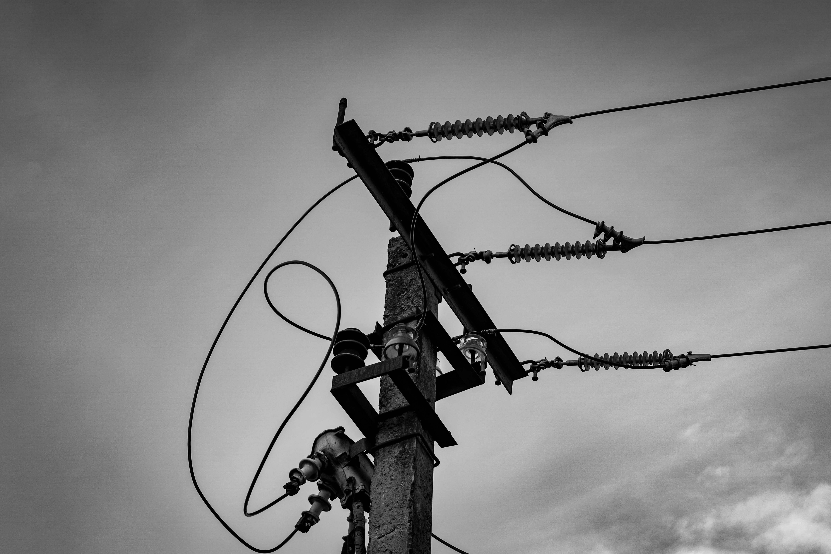
Objective :
The primary objective of this project is to develop a machine learning-based system for accurate and reliable electricity consumption prediction, enabling better energy management and contributing to sustainable energy practices. The specific objectives are:
Accurate Prediction: Develop machine learning models to forecast electricity consumption using historical data and key factors like weather and time.
Energy Optimization: Help utility providers and consumers reduce energy waste and operational costs through precise forecasting.
Grid Stability: Support energy providers in managing peak demand and ensuring reliable energy supply.
Sustainability: Promote efficient energy use and integration of renewables to support global sustainability goals.
Dynamic Adaptation: Create models that adapt to changing consumption patterns over time.

Slide 8
Literature Survey
Reference | Authors | Year Published | Methodology | Data Used | Key Findings
"Improving Electric Energy Consumption Prediction Using CNN and Bi-LSTM" | Vo, B., Hwang, E., Rho, S., and Baik, S.W | 2019 | Combination of Convolutional Neural Networks (CNN) and Bi-LSTM for time-series forecasting. | Household electricity usage data | CNN and Bi-LSTM framework outperformed traditional methods for real-time, short-term, and long-term predictions​
"A Hybrid Model for Electricity Consumption Forecasting" | Liu, S., Tang, Y., and Zhang, J. | 2019 | Hybrid ensemble combining regression and neural network models. | Monthly electricity demand data | Improved prediction accuracy for urban electricity consumption trends by 15%​
"Electricity Load Forecasting in Smart Grids" | Singh, P., and Yadav, S. | 2023 | Use of Random Forest regression and feature selection techniques for load forecasting in smart grids. | Smart meter and weather data | Random Forest proved effective in capturing complex patterns in electricity consumption​
"Long-term Electricity Demand Forecasting" | Choi, H., Lee, K., and Park, J. | 2021 | Econometric and system dynamics modeling for urban electricity demand prediction. | Population growth and GDP data | Long-term demand correlated strongly with urbanization

Slide 9

Methodology and Tools :
Methodology:
Data Collection: Gather historical electricity consumption and external factors (e.g., weather, seasons).
Data Preprocessing: Clean and normalize data, handle missing values, and engineer features.
Exploratory Data Analysis (EDA): Identify patterns and trends in electricity usage.
Model Development: Train and test models like regression, random forests, XGBoost, and LSTMs for prediction.
Model Evaluation: Assess accuracy using metrics like MAE, RMSE, and R².
Deployment: Deploy the best-performing model via APIs or cloud platforms for real-time predictions.
Tools:
Programming: Python (Pandas, NumPy, Scikit-learn, TensorFlow, Keras )
Visualization: Matplotlib, Seaborn, Tableau, or Power BI
Storage: MySQL, PostgreSQL
Deployment: Flask, Django, AWS, or Google Cloud
External Data: OpenWeatherMap API for weather integration
Version Control: Git/GitHub

Slide 10

Implementation
Problem Definition:
Goal: Accurately predict electricity consumption for better energy management.
Key factors: Time, temperature, seasonal trends, and historical usage data.
Data Collection:
Collect electricity usage data and external factors like weather using APIs (e.g., OpenWeatherMap).
Data Preprocessing:
Handle missing values, normalize data, and engineer features.
Split data into training, validation, and test sets.
Model Development:
Train and evaluate models: Linear Regression, Random Forest, XGBoost, and LSTM.
Tune hyperparameters and evaluate with metrics (MAE, RMSE, R²).
Model Deployment:
Deploy the best model using Flask/Django for APIs and host on cloud platforms (AWS, Google Cloud).
Visualization & Insights:
Create dashboards in Tableau or Power BI to present predictions and actionable insights.
Monitoring & Maintenance:
Continuously monitor model performance and retrain with new data for accuracy.

Slide 11
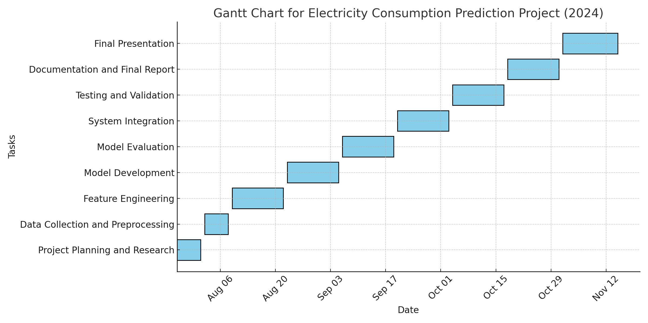
Gantt Chart

Slide 12
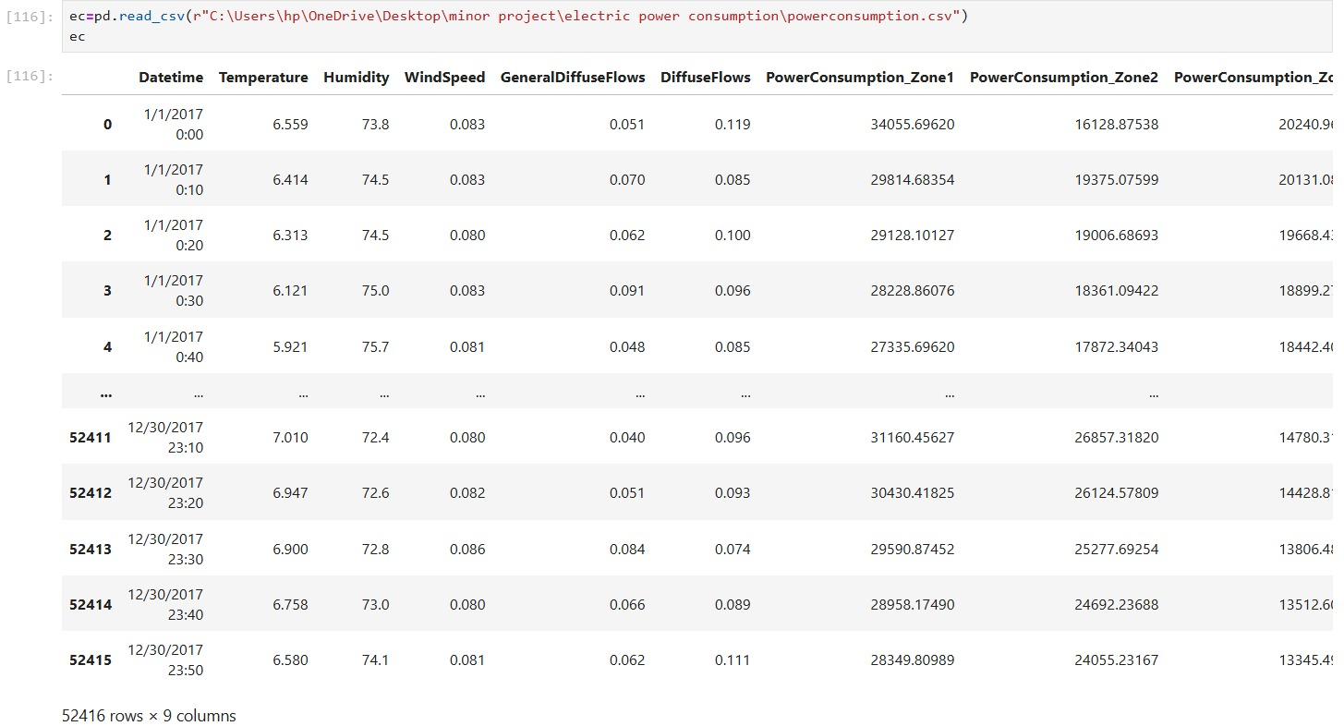
Data Reading

Slide 13
Feature Engineering
Feature engineering is a critical step in any machine learning project, including electricity consumption prediction. It involves creating meaningful features from raw data that can help improve model performance. Here’s a comprehensive breakdown of feature engineering for an electricity consumption prediction project:
1. Data Preprocessing
Handling Missing Data: Impute missing values using techniques like mean, median, or interpolation for time series data.
Handling Outliers: Identify and handle outliers using methods like Z-score or IQR (Interquartile Range).
2. Time-based Features
Since electricity consumption typically follows daily, weekly, and seasonal patterns, it's important to extract time-based features:
Hour of the Day: Electricity usage can vary based on the time of day (e.g., peak hours in the evening).
Day of the Week: Consumption can differ between weekdays and weekends.
Month of the Year: There could be seasonal patterns (e.g., higher consumption in summer due to air conditioning).
Is Weekend/Is Holiday: Electricity consumption is usually lower on weekends or holidays. Marking these can be helpful.
Season: Encode seasons (Winter, Spring, Summer, Fall) based on month.
3. Lag Features
Previous Consumption: Use lag features (e.g., consumption from the previous day, week, or month) to capture trends and autocorrelation in the data.
Rolling Window Statistics: Calculate rolling means, medians, or sums over a window (e.g., 7-day rolling average) to smooth out noise and detect patterns.
4. Weather Data
Weather is a major factor influencing electricity consumption (e.g., air conditioning use in hot weather, heating in cold weather).
->Temperature ->Humidity ->Wind Speed ->Rain/Snow
5. Lag Features for Weather
Previous Temperature/Humidity: Similar to the consumption lag features, weather from previous days can help predict energy usage.
6. External Economic Indicators
If available, include external factors like economic activity, GDP, or industrial activity which could influence energy demand.

Slide 14
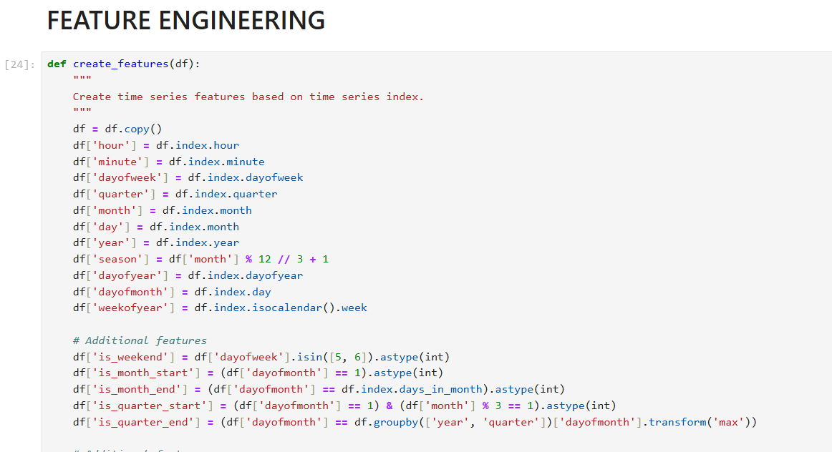

Slide 15
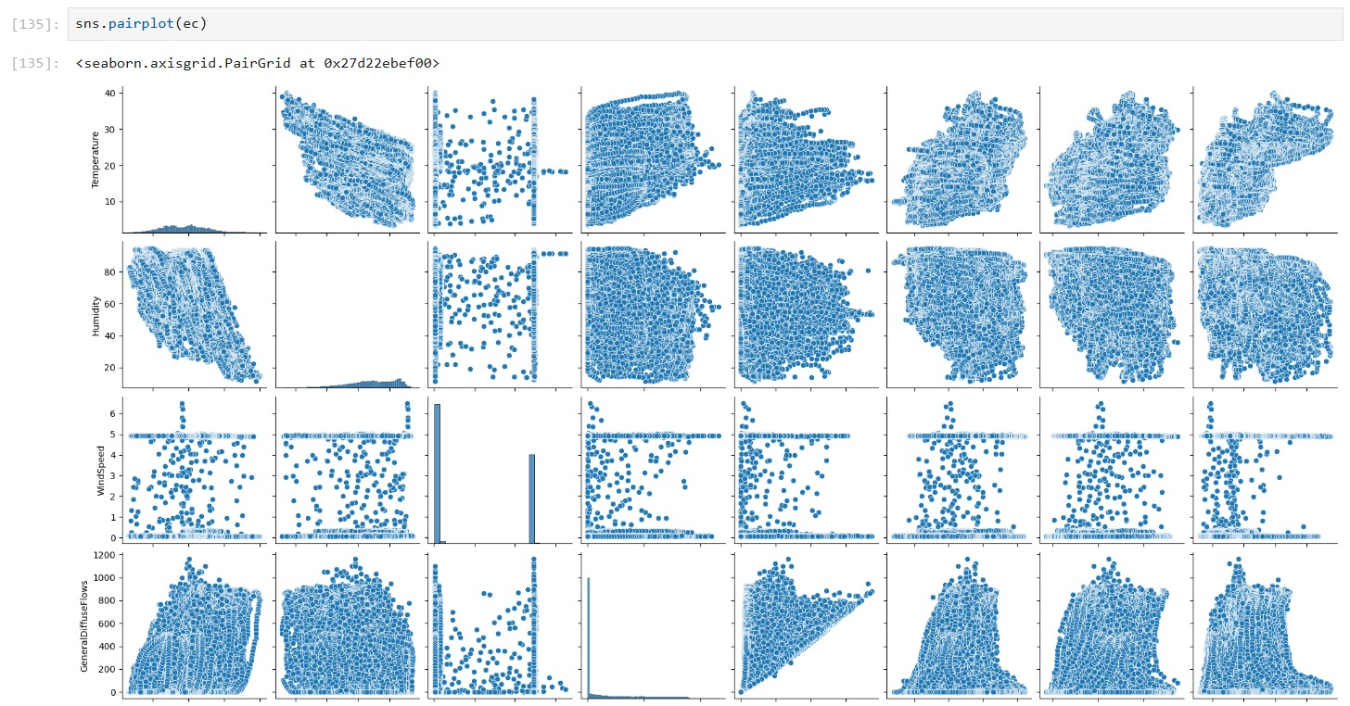
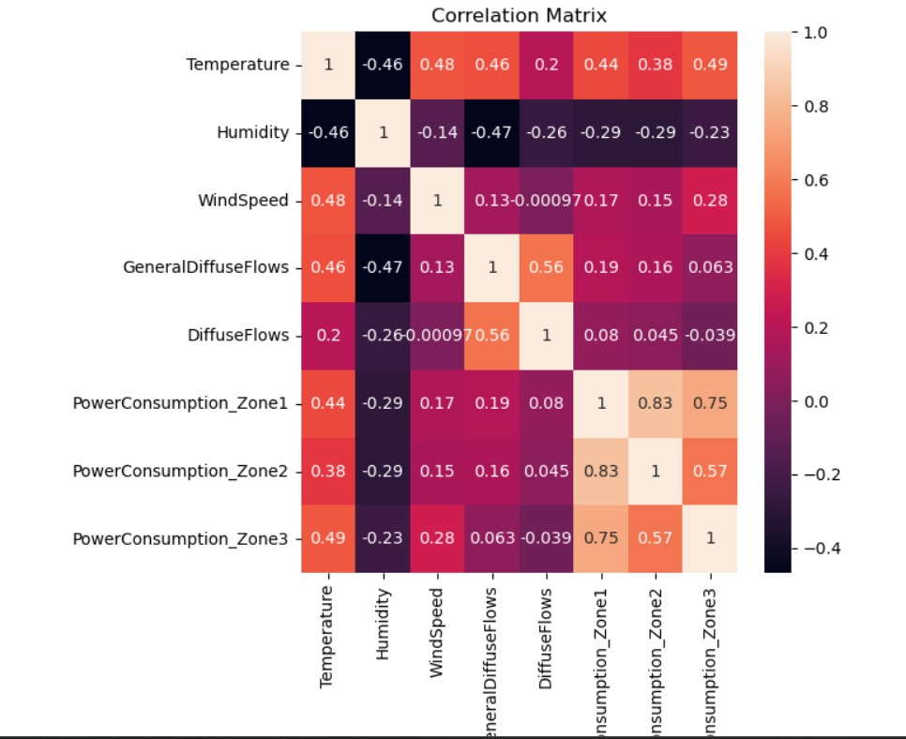
Data Visualization :

Slide 16
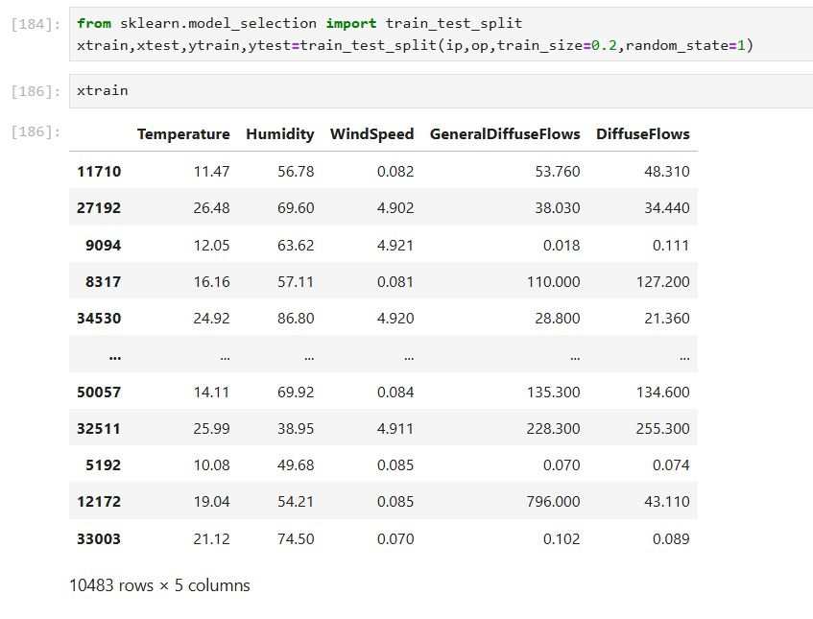
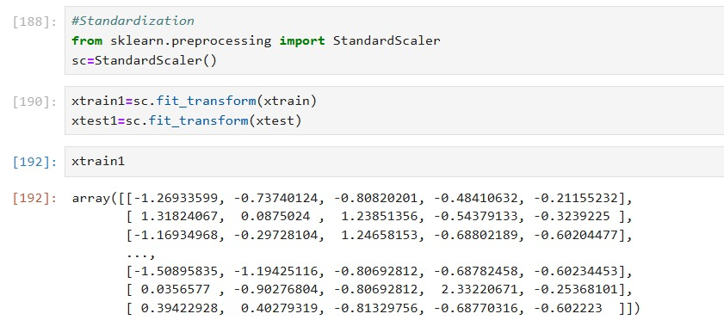
Model Training :

Slide 17
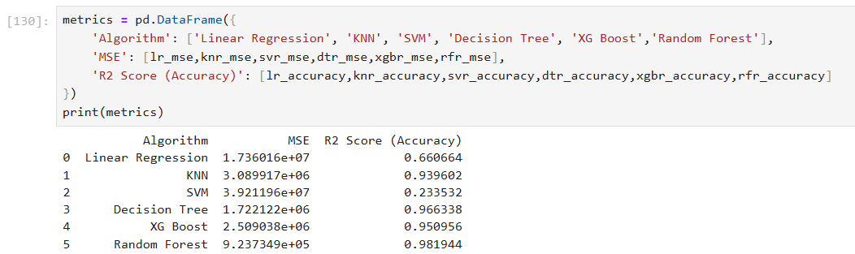
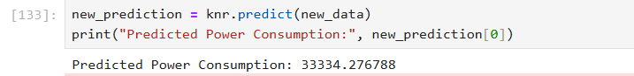
Model Evaluation:
Prediction Result

Slide 18
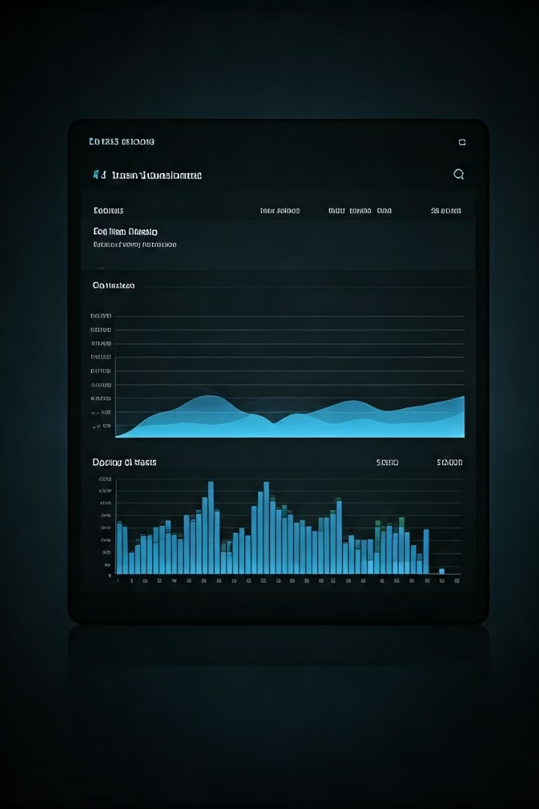
Electricity Consumption Prediction Using Machine Learning
With the trained model, we can now predict future electricity consumption. The model takes input features, such as weather data, economic indicators, and historical consumption patterns, and outputs a prediction of electricity consumption for a specific time period. The accuracy of the prediction depends on various factors, including the quality of the data, the complexity of the model, and the predictability of the consumption patterns.
Algorithm
Advantages
Disadvantages
Linear Regression
Simple, interpretable, efficient for linear relationships
Sensitive to outliers, assumes linear relationships
Support Vector Machines (SVM)
Robust, effective for complex relationships, handles high-dimensional data
Less interpretable than linear regression, can be computationally expensive
KNN
Simplicity, No Training Phase, Versatility, Adaptability
Computationally Intensive, Memory Intensive, Distance Metric

Slide 19

Conclusion:
Electricity consumption prediction using machine learning has the potential to revolutionize the energy sector by improving efficiency, reducing costs, and supporting sustainability. ML models can optimize energy use, integrate renewable sources, and ensure grid stability through real-time monitoring, demand forecasting, and personalized recommendations. Challenges such as data privacy, real-time computation, and model interpretability must be addressed, but the future of ML in energy management looks promising, paving the way for smarter, greener, and more resilient energy systems.
In conclusion, the future of electricity consumption prediction is promising. By harnessing the power of machine learning, we can create smarter, more efficient, and sustainable energy systems that not only meet the needs of today but also pave the way for a greener, more resilient future

Slide 20

Future Scope:
The future scope of electricity consumption prediction using machine learning (ML) is promising, as it has the potential to revolutionize how energy is managed, distributed, and conserved. Several advancements and applications are expected in the near future. Below are key areas where machine learning can impact electricity consumption prediction:
Smart Grids and Demand Response
Energy Efficiency Optimization
Advanced Forecasting Models
IoT and Smart Meter Data
Artificial Intelligence and Deep Learning
Energy Trading and Market Prediction
Decentralized Energy Systems
Sustainability and Environmental Impact

Slide 21
Reference:
[1] "Short-Term Load Forecasting Using Artificial Neural Networks" by Hong et al. (1996)
[2] "Time Series Forecasting of Building Energy Consumption: A Review" by Zhao et al. (2019).
[3] "Smart Meter Data Analytics for Energy Consumption Forecasting: A Review" by Li et al. (2018)
[4] Energy Consumption Prediction in Smart Grids: A Review of Machine Learning Techniques" by Alfares and Nazeeruddin (2016).
[5] Hong, T., & Wan, K. (2018). Short-term building energy prediction based on gradient boosting machine learning algorithm. Applied Energy, 230, 659-675. [6] Zhang, C., Li, L., & Chen, J. (2020). An improved SVM model for short-term wind power prediction. Energy Procedia, 158, 4383-4388.
[7] Wang, Y., Tao, F., & Zuo, Y. (2020). A deep learning framework for building energy consumption prediction considering seasonal characteristics. Energy and Buildings, 220, 110063.
[8] Liu, Y., Zhong, X., & Li, Y. (2019). LSTM-based prediction of short-term building energy consumption under different weather conditions. Energy and Buildings, 204, 109512.
[9] Xu, J., Chen, H., & Luo, Z. (2021). A hybrid model for short-term wind speed prediction based on feature selection and XGBoost algorithm. Renewable Energy, 174, 1195-1207.
[10] Mohammadi-Ivatloo, B., Rabiee, A., & Pahwa, A. (2018). Short-term wind power prediction based on LSTM neural networks. Applied Energy, 220, 296-306.
[11] Mohanty, S., Choudhury, A., & Das, A. (2019). Exploratory Data Analysis and Feature Selection for Short-Term Load Forecasting in Indian Power Systems. *International Journal of Electrical Power & Energy Systems*, 110, 515-526.
[12] Sharma, A., Gupta, S., & Chakraborty, D. (2018). Exploratory Data Analysis of Energy Consumption Patterns in Indian Agricultural Sector: A Case Study in Punjab. *Energy for Sustainable Development*, 43, 218-227.
[13] Singh, R., Jha, A., & Tripathy, B. (2021). Predictive Modelling of Energy Consumption in Indian Industrial Sector Using Machine Learning Algorithms. *Journal of Cleaner Production*, 318, 128592.
[14] Mishra, S., Tiwari, P., & Singh, M. (2020). A Comparative Analysis of Machine Learning Algorithms for Short-Term Load Forecasting in Indian Urban Areas. *Applied Energy*, 263, 114617.
[15] Gupta, A., Rani, S., & Tiwari, A. (2019). Predictive Modelling of Energy Consumption in Indian Healthcare Sector Using Ensemble Learning Techniques. *Energy Reports*, 5, 98-107. Predictive Modelling of Energy Consumption in Indian Telecommunications Sector Using Support Vector Machines. *Journal of Energy Engineering*, 145(1), 04018064.

Slide 22
THANK YOU

